Slide 1

MANAGEMENT OF NATURAL RESOURCES
Sustainable Developement

Slide 2



The concept of sustainable development encourages forms of growth that meet current basic human needs, while preserving the resources for the needs of future generations.

Slide 3


Economic development is linked to environmental conservation.

Slide 4
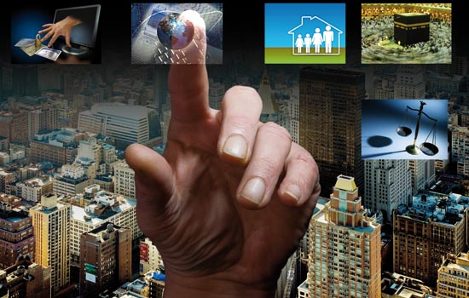
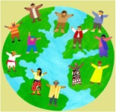
Thus sustainable development implies a change in all aspects of life.

Slide 5
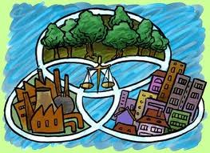
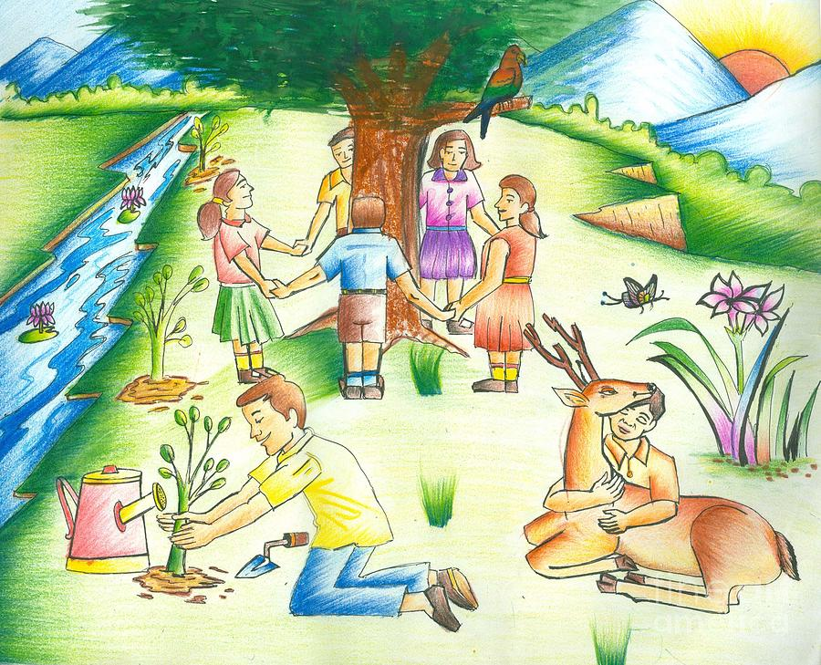
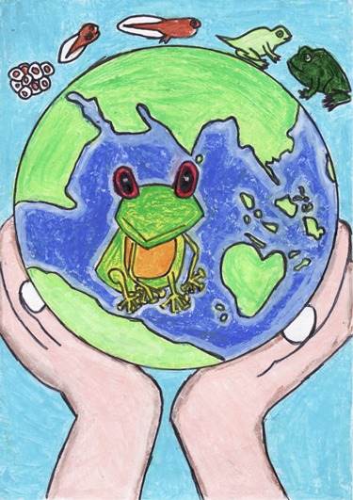
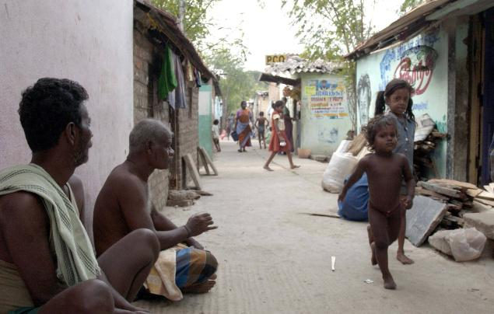

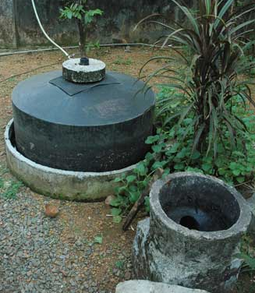
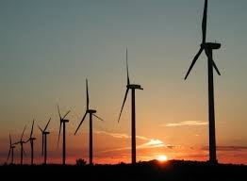
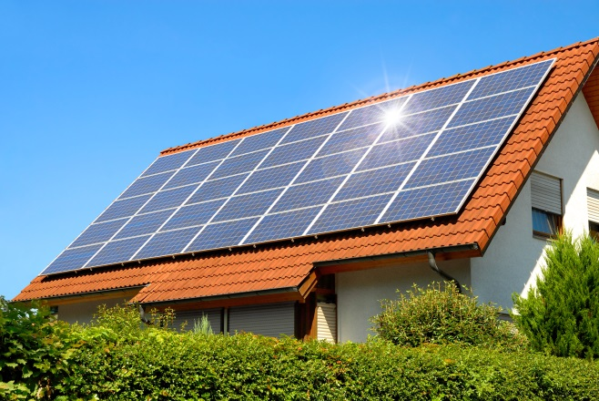
Sustainable development depends upon
The willingness of the people to change their perceptions of
Socio-economic conditions
Environmental conditions
And the readiness of each individual to alter their present use of natural resources.

Slide 6
Thank You

